Slide 1
MEDIA MANAGEMENT AND MARKETING

Slide 2
Strategic Planning
&
Market Analysis

Slide 3
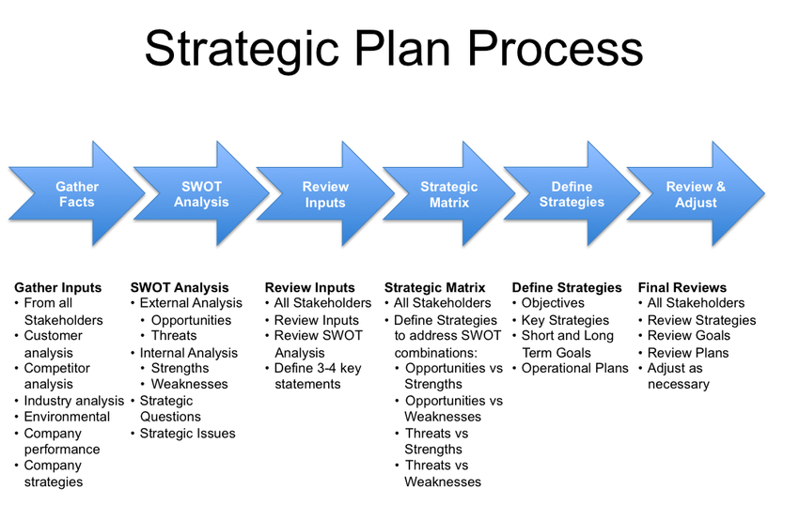

Slide 4
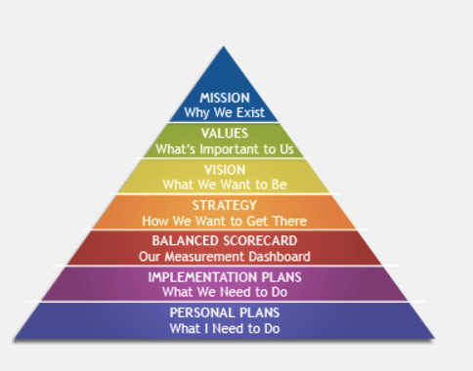

Slide 5
Strategic planning
The strategic planning process requires considerable thought and planning on the part of a company’s upper-level management. Before settling on a plan of action and then determining how to strategically implement it, executives may consider many possible options. In the end, a company’s management will, hopefully, settle on a strategy that is most likely to produce positive results (usually defined as improving the company’s bottom line) and that can be executed in a cost-efficient manner with a high likelihood of success, while avoiding undue financial risk.

Slide 6
Strategic planning
The development and execution of strategic planning are typically viewed as consisting of being performed in three critical steps:
1. Strategy Formulation
2. Strategy Implementation
3. Strategy Evaluation

Slide 7
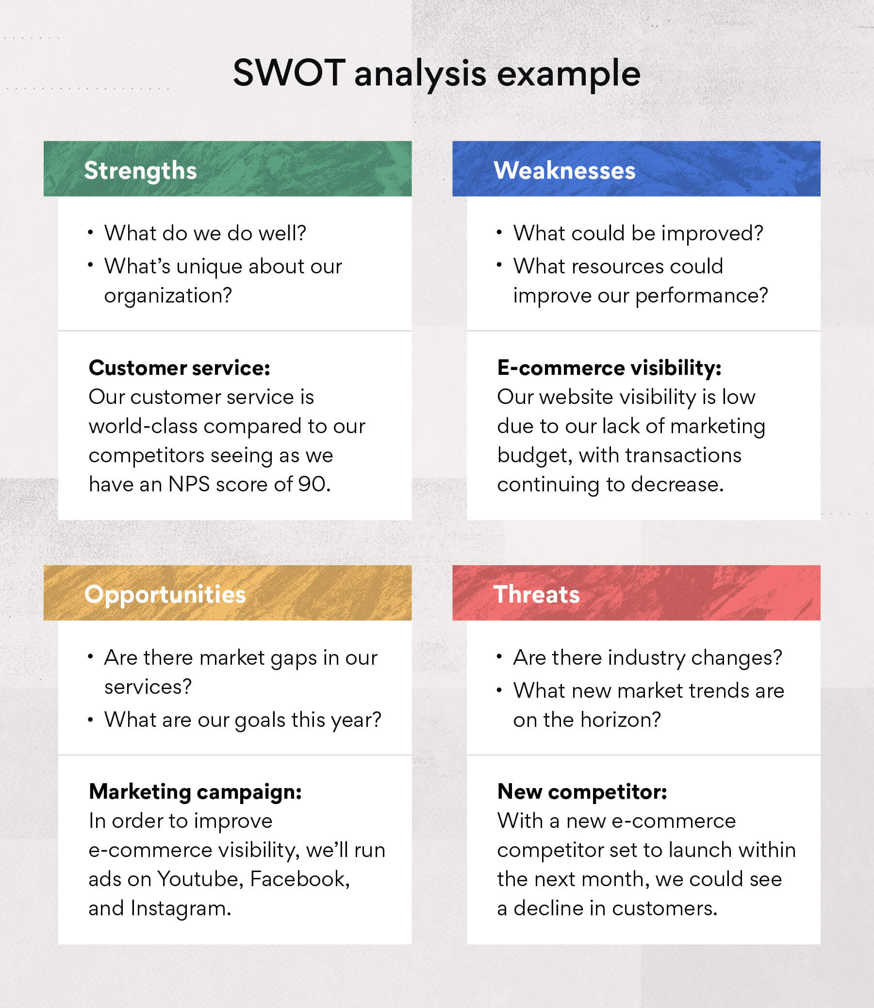
Strategic planning

